Slide 1
Low-Latency Pipelined RISC-V 32-bit Processor
Group Members
R22EN045 – Mithun Nagaraja
R22EN043 – Manjunath S R
R22EN048 – Nagachandra I D
R22EN021 – Darshan N A
Major Project - Phase 2
Guide: Dr. Nayana D K

Slide 2
Contents
Abstract
Introduction
Literature Survey
Problem Statement
Objective
Methodology
Block Diagram
Applications
Output / Result
Conclusion
References

Slide 3
Abstract
This project focuses on designing and implementing a low-latency 32-bit RISC-V processor using a five-stage pipelined architecture to overcome limitations associated with single-cycle and non-pipelined processors, which generally suffer from high execution latency. The proposed design adopts the RV32 instruction set and includes pipeline stages: Instruction Fetch (IF), Decode (ID), Execute (EX), Memory Access (MEM), and Write Back (WB). The implementation aims to enhance instruction throughput, reduce execution time, and efficiently manage hazards through forwarding logic and optimized control. The processor will be verified through simulation and synthesis to analyze its performance and compare it with non-pipelined architecture. This work supports the development of efficient embedded and real-time computing solutions.

Slide 4
Introduction
RISC-V is an open-source Reduced Instruction Set Computing (RISC) architecture.
The RISC-V architecture offers an open, modular foundation for processor design, enabling high customization and academic exploration. This project presents a Low-Latency Pipelined 32-bit RISC-V Processor, implementing a five-stage pipeline (Fetch, Decode, Execute, Memory Access, Write Back) to improve instruction throughput and reduce execution time. The design focuses on minimizing pipeline hazards through data forwarding and efficient control logic, making it suitable for embedded and real-time applications where performance and efficiency are critical.

Slide 5
Literature Survey
Processor designs have evolved from single-cycle execution architectures to multi-cycle and pipelined processors to improve processing speed. Single-cycle designs, although simple, are limited by lower clock frequency and increased latency due to a long combinational path. Researchers have demonstrated that pipelining significantly reduces execution delay by overlapping operations of multiple instructions.
Recent works in RISC-V microarchitecture development highlight the following key advancements:
Five-stage RV32I pipelines achieve better performance by balancing critical path delay.
Hazard detection and data forwarding are essential for maintaining instruction flow.
Modular and open-source design encourages educational usage and industry adoption.
Efficient pipeline control leads to optimized latency and reduced CPI

Slide 6
Literature Survey
Performance-Optimized RV32I Five-Stage Pipeline (NRP Processor):
A more recent work introduces an optimized RV32I five-stage pipeline processor referred to as NRP. The authors propose two main microarchitectural optimizations: an improved instruction decoding unit and a simple branch-prediction scheme to reduce control-hazard penalties. These enhancements lead to better CPI and higher overall performance without dramatically increasing hardware complexity. This work shows that even within a standard five-stage pipeline, careful redesign of the decode and control stages can directly contribute to lower effective latency.
Chang et al. – Configurable Five-Stage RV32IM Core
Chang et al. designed a configurable five-stage pipeline processor core based on RV32IM, where the architecture can switch between a low-power mode (RV32I only) and a high-performance mode (with multiplication/division extension). The pipeline structure remains five stages, but several modules are configurable according to application needs.

Slide 7
Problem statement
Existing single-cycle or non-pipelined processors have higher latency.
To design and implement a low-latency, five-stage pipelined 32-bit RISC-V processor that minimizes pipeline hazards and maximizes instruction throughput while maintaining architectural simplicity and energy efficiency

Slide 8
objectives
Implement a 5-stage pipelined RISC-V 32-bit Processor.
Achieve low-latency operation.
Verify through simulation and synthesis.
Compare performance with non-pipelined designs.

Slide 9
Methodology
Study the RV32 instruction set.
Design core pipeline stages: IF, ID, EX, MEM, WB.
Implement forwarding and hazard detection units.
Simulate using EdaPlayground or Vivado.
Verify correctness and performance metrics (CPI, latency).

Slide 10
Project PROGRESS
Completed design and verification of 32-bit Arithmetic Logic Unit (ALU).
Implemented status flags (Zero, Carry, Overflow, etc.) for operation results.
Verified functionality through simulation.
Next Phase
Begin RISC-V assembly level coding.
Develop test programs to validate instruction execution and processor functionality.

Slide 11
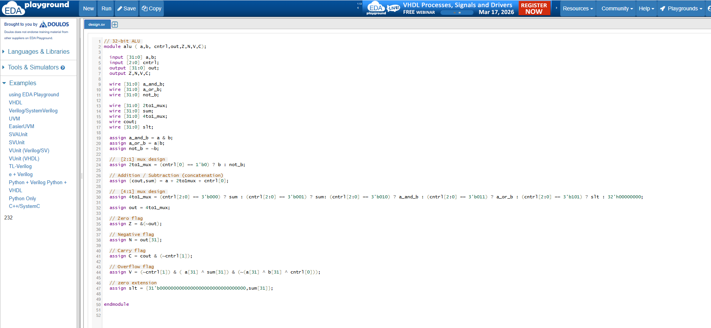
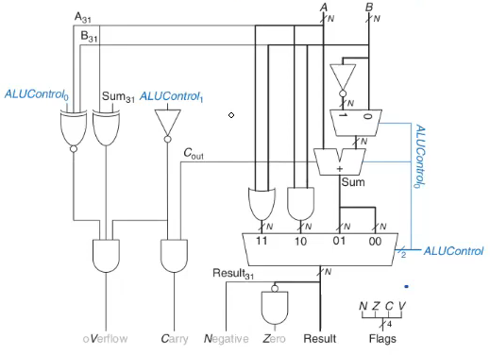
CURRENT PROGRESS

Slide 12
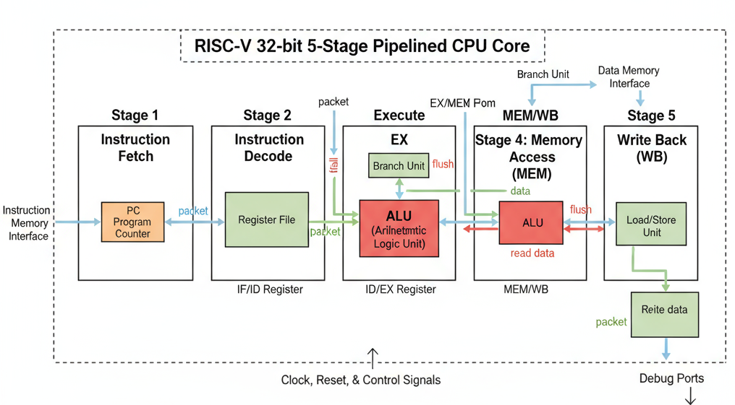
Block diagram

Slide 13
Applications
Embedded Systems and Controllers
Suitable for microcontroller-based applications including industrial automation, consumer electronics, and control systems due to its reduced latency and fast instruction execution
Real-Time Systems
Applications like robotics, drones, medical monitoring devices, and automotive electronics require quick instruction throughput and deterministic timing.
FPGA-based Accelerator Architectures
Can be integrated as a custom processing core inside FPGA-based systems to provide higher performance for AI, DSP, or multimedia tasks with specialized extensions.

Slide 14
SDG MAPPING
SDG-4: Quality Education
Helps students gain knowledge in modern CPU design, microarchitecture, pipelining, and open-source hardware (RISC-V), enhancing technical education.
SDG-9: Industry, Innovation and Infrastructure
Contributes to innovation in processor architecture, supports research in custom SoC design, and advances embedded industry technology.
SDG-8: Decent Work and Economic Growth
Promotes semiconductor skills, hardware design expertise, and supports the growing RISC-V industry leading to employment opportunities.

Slide 15
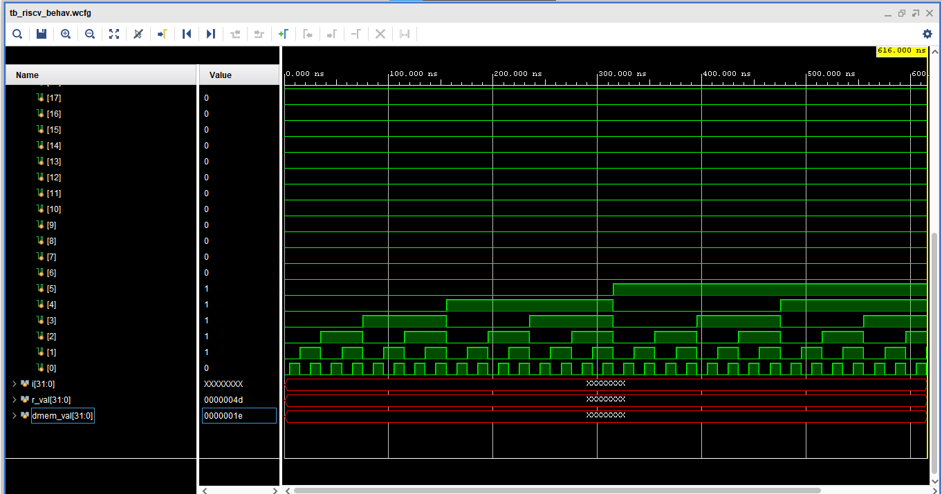
Output / Result

Slide 16
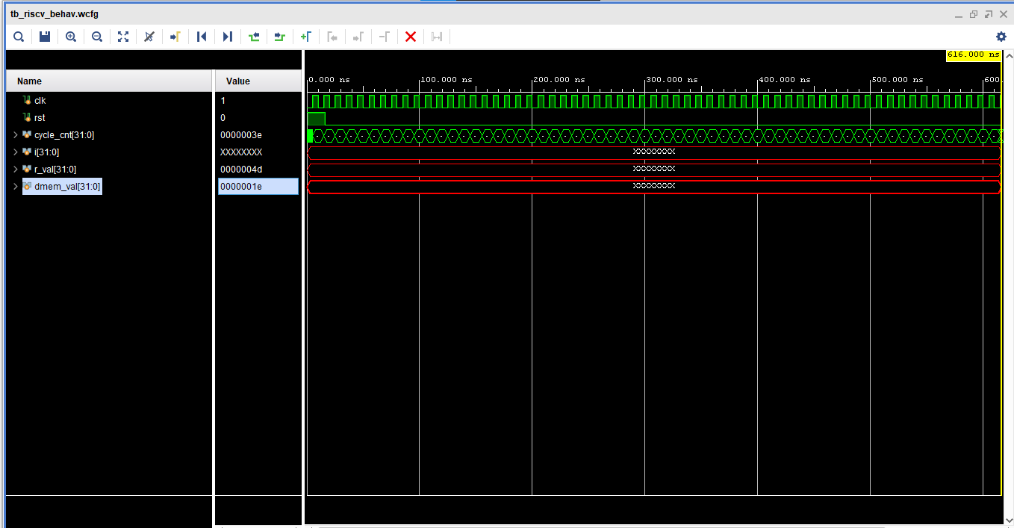

Slide 17
CONCLUSION
We have selected the Low-Latency Pipelined 32-bit RISC-V Processor as our major project to gain hands-on experience in modern CPU architecture and digital design principles. This project focuses on implementing a five-stage pipeline (Fetch, Decode, Execute, Memory Access, Write Back) to enhance instruction throughput and reduce execution latency, leveraging the open-source and modular nature of the RISC-V ISA.
The design and development are currently in progress, with emphasis on efficient pipelining, hazard detection, and data forwarding mechanisms. While the final implementation and simulation results are yet to be completed, we are confident in delivering a fully functional processor core that meets the defined performance and educational objectives. This project lays a strong foundation for future extensions such as branch prediction, SoC integration, and FPGA prototyping

Slide 18
References
Patterson, D. A., & Waterman, A., “The RISC-V Reader: An Open Architecture Atlas,” 1st Edition, Strawberry Canyon LLC, 2017.
Waterman, A., Asenova, K., “The RISC-V Instruction Set Manual – Volume I: User-Level ISA,” RISC-V Foundation, 2019.
Harris, D. & Harris, S., “Digital Design and Computer Architecture – RISC-V Edition,” Morgan Kaufmann, 2021.
Hennessy, J. & Patterson, D., “Computer Architecture: A Quantitative Approach,” 6th Edition, Morgan Kaufmann, 2019.
Miyazaki, H., Kanamori, T., Islam, M. A., & Kise, K. “ RVCore : An optimized RISC-V soft processor of five-stage pipelining.” (2020) demonstrates a five-stage RV32I soft-core optimized for FPGAs, with improved operating frequency via instruction-fetch, ALU, and data-alignment optimizations.
Li, H., Jing, C., & Liu, J. — “Performance-Optimized Design of the RISC-V Five-Stage Pipelined Processor NRP” (2024) — describes optimizations to instruction decode and branch handling to improve performance on a five-stage RV32I pipeline, with evaluation on FPGA.

Slide 19
Thank You…..

